Slide 1


Workshop On Management Of Flexible Workforce
Dr G. MANJUNATH KLS., Phd
Additional Labour Commissioner
(Industrial Relations)
Govt. of Karnataka

Slide 2


Workshop On Management Of Flexible Workforce

Slide 3
Introduction
1)Conceptualising Flexible Workforce
2)Part A - Covid 19 and the Impact on Labour Market
3)Part B – European Union and US
4)Part C - World Employment and Social Outlook Trends
5)Part D - Non Standard Employment
6)Part E - Workforce Ecosystems
7)Part F - Future of Work/Labour Markets
8)Part G - Summary and Conclusions.
Workshop On Management Of Flexible Workforce

Slide 4
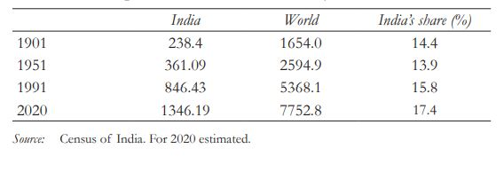
Fig 1: Population of India and the world (in millions)
Workshop On Management Of Flexible Workforce

Slide 5
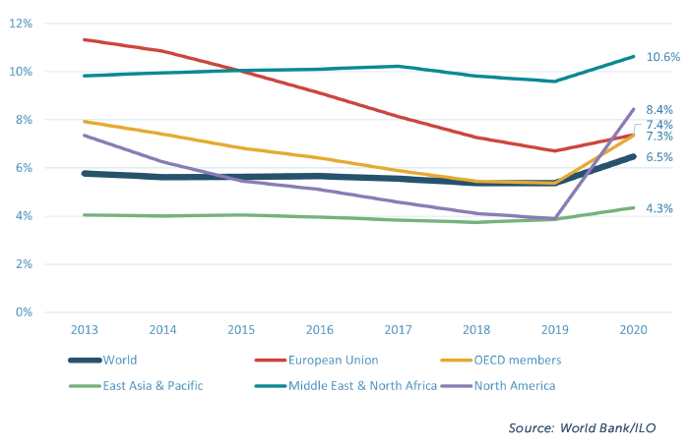
Fig 2: Regional unemployment rates
Workshop On Management Of Flexible Workforce

Slide 6
Fig 3: Demographic Composition(in %) in India (2011-2036)
Workshop On Management Of Flexible Workforce

Slide 7
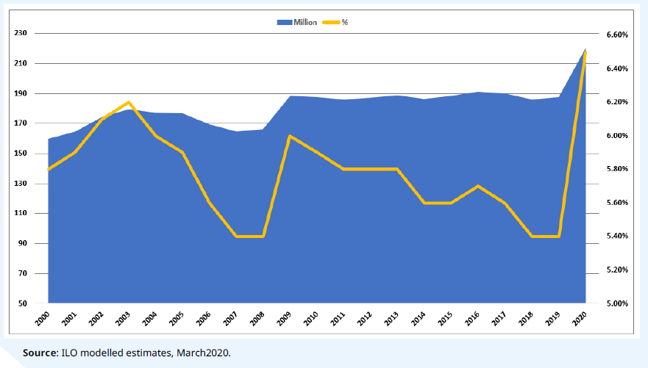
Fig 4: Global unemployment rate, 2000-2020
Workshop On Management Of Flexible Workforce

Slide 8
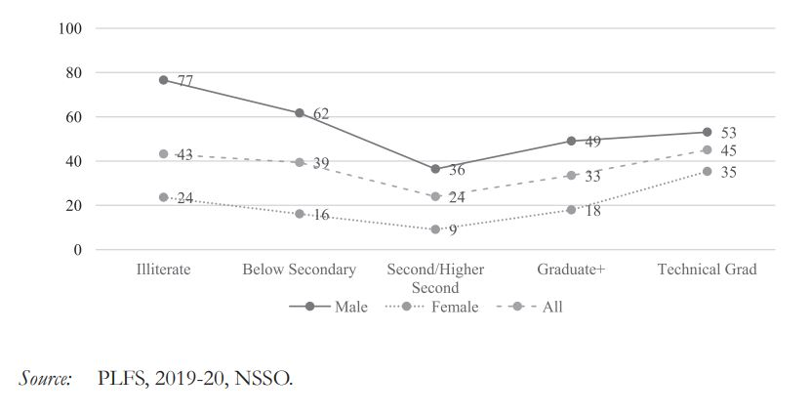
Fig 5: Level of Education and Work Force Participation Rate(%) of Youth (15-29 years): 2019-20 (Ups)
Workshop On Management Of Flexible Workforce

Slide 9
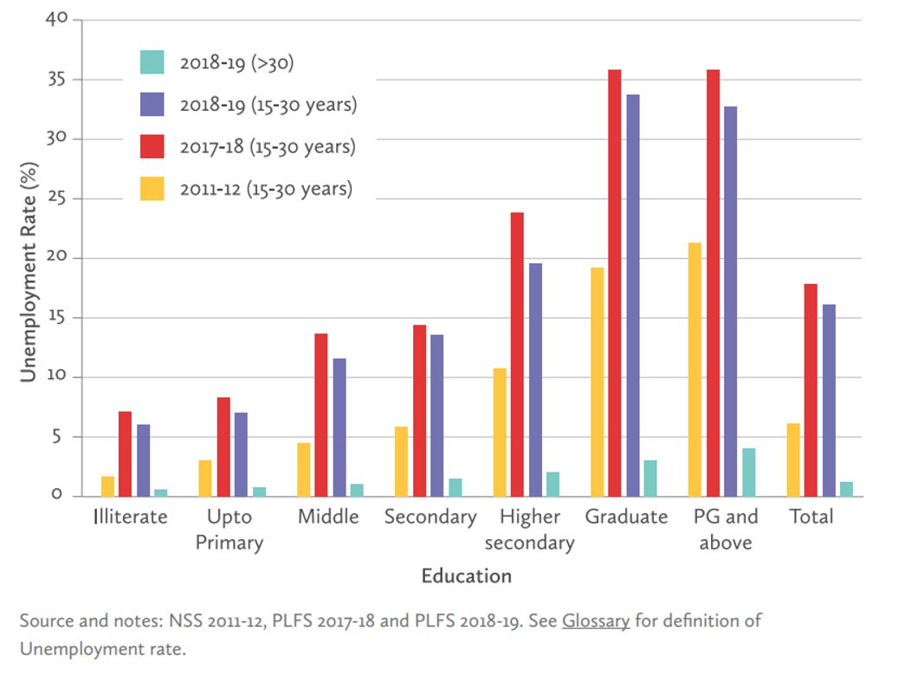
Fig 6: Unemployment in India is concentrated among educated youth
Workshop On Management Of Flexible Workforce

Slide 10
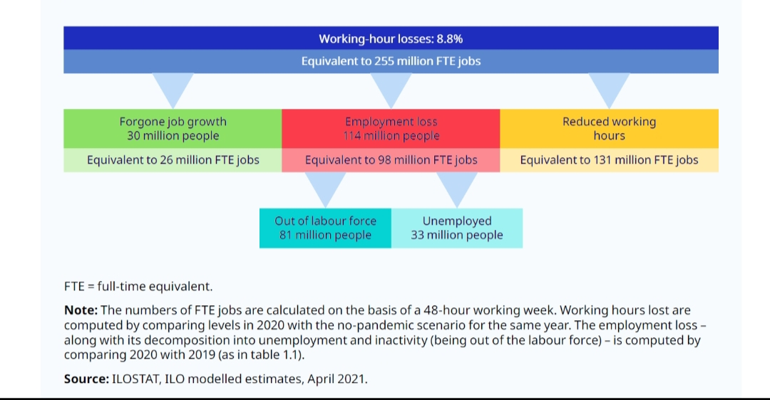
Fig 7: Global Working Hour Losses in 2020
Workshop On Management Of Flexible Workforce

Slide 11

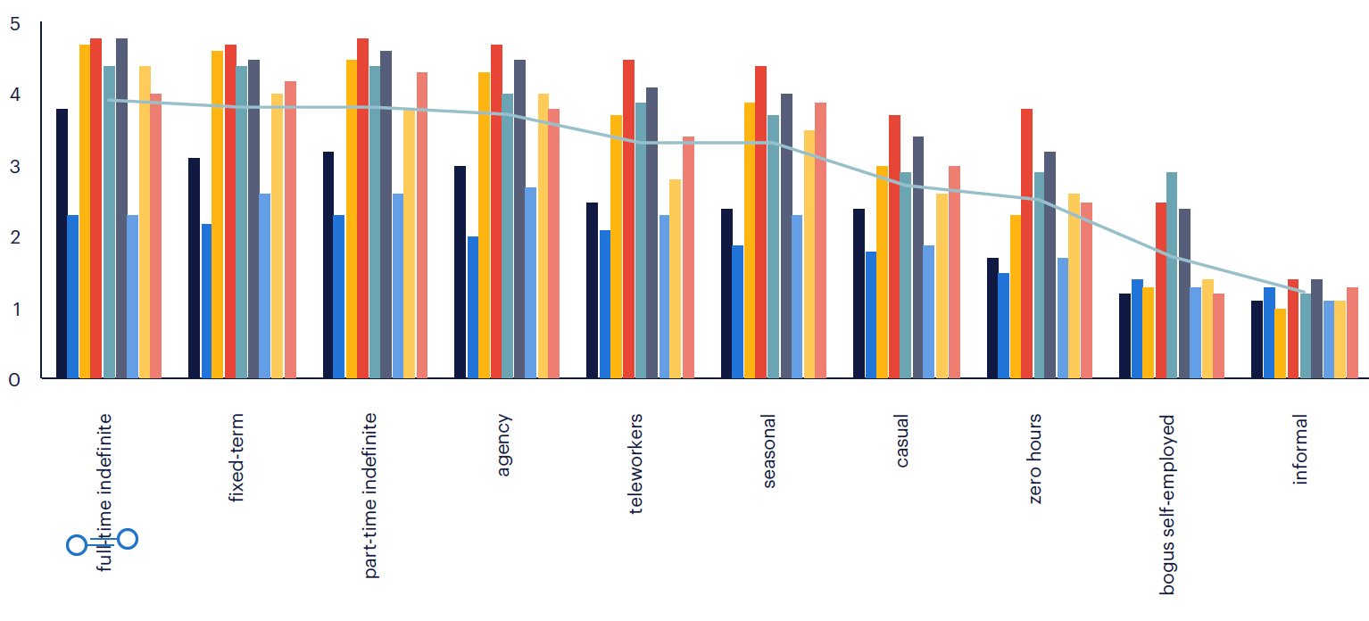
Fig 8: Employment Relationships and Rights in 12 EU Member States
Workshop On Management Of Flexible Workforce

Slide 12
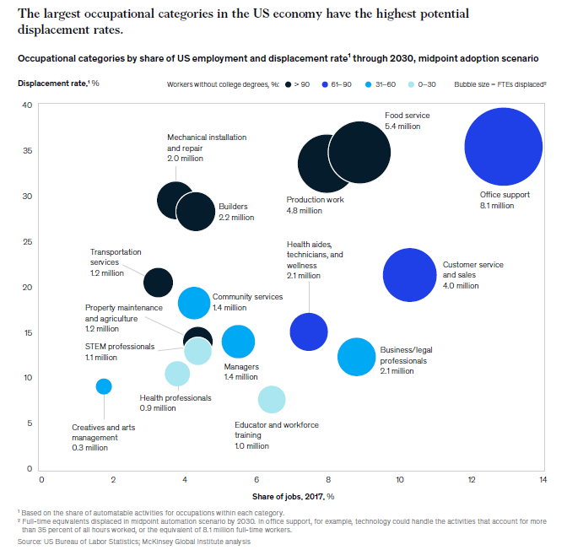
Fig 9: America displacement of jobs
Workshop On Management Of Flexible Workforce

Slide 13
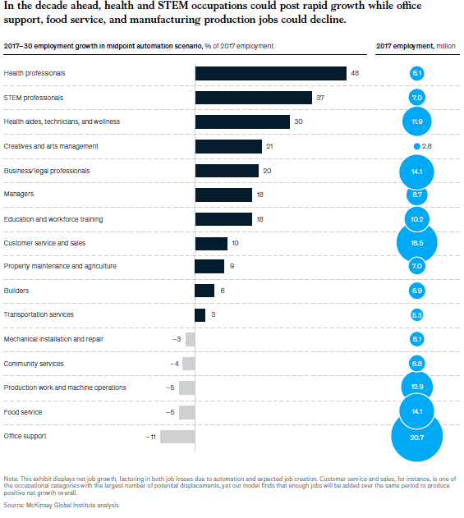
Fig 10: New jobs in America
Workshop On Management Of Flexible Workforce

Slide 14
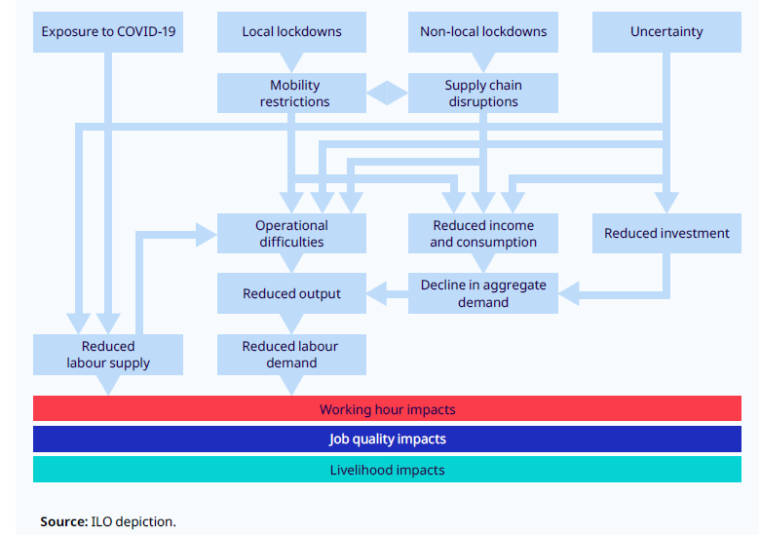
Fig 11: Impact channels of the Covid-19 crisis
Workshop On Management Of Flexible Workforce

Slide 15
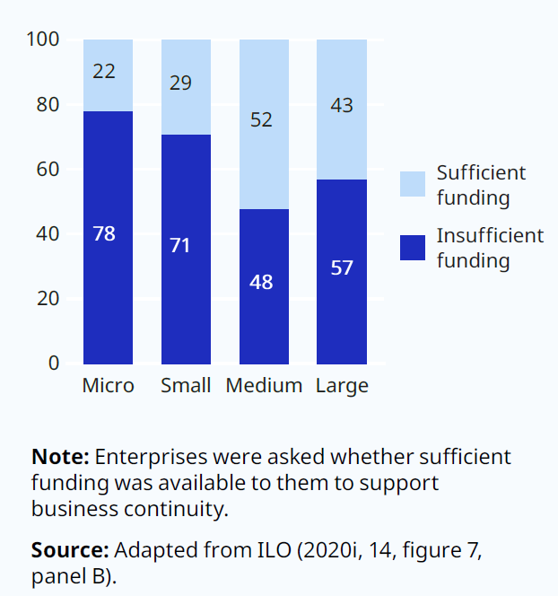
Fig 12: Sufficiency of funding for business continuity by size of enterprise , 2020
Workshop On Management Of Flexible Workforce

Slide 16
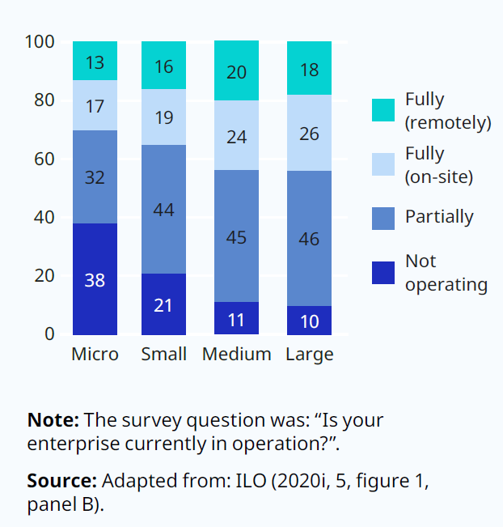
Fig 13: Operational status of enterprises during the Covid 19 crisis, by size, 2020
Workshop On Management Of Flexible Workforce

Slide 17
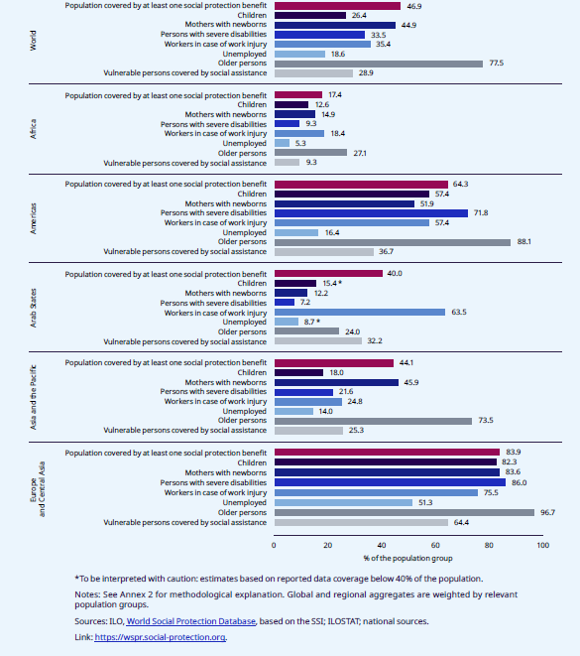
Fig 14: Effective social protection coverage, global and regional estimates by population group, 2020
Workshop On Management Of Flexible Workforce

Slide 18
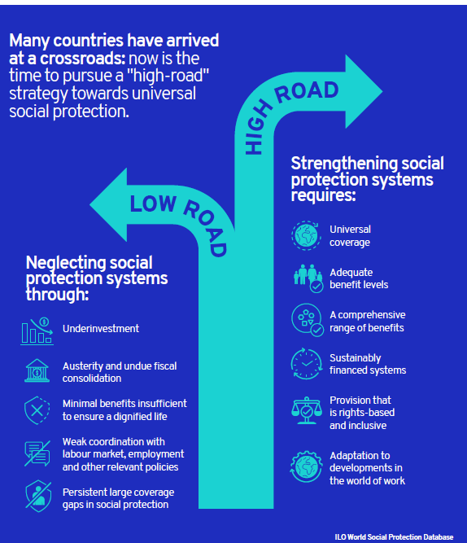
Fig 15: Taking the high road towards universal social protection for a socially just future
Workshop On Management Of Flexible Workforce

Slide 19
Fig 16: Unemployment in India is concentrated among educated youth
Workshop On Management Of Flexible Workforce

Slide 20
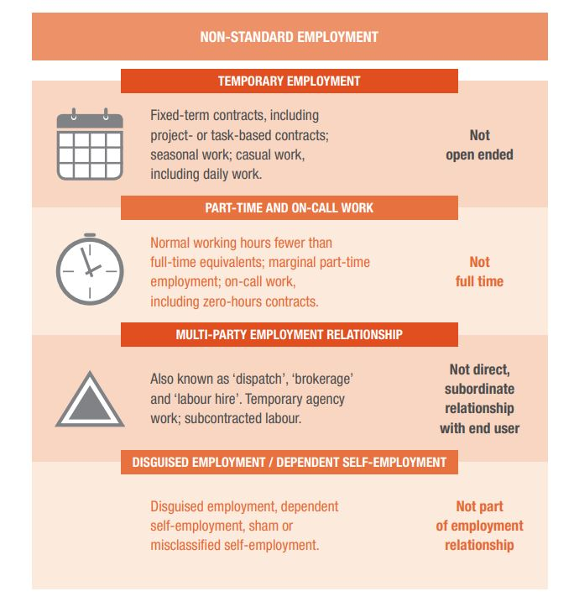
Fig 17: Non Standard Employment
Workshop On Management Of Flexible Workforce

Slide 21
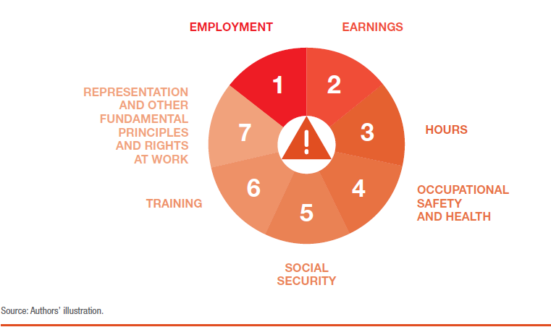
Fig 18: Seven areas of potential work insecurity
Workshop On Management Of Flexible Workforce

Slide 22
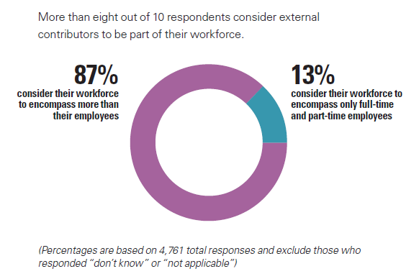
Fig 19: A Broader view of the Workforce
Workshop On Management Of Flexible Workforce

Slide 23
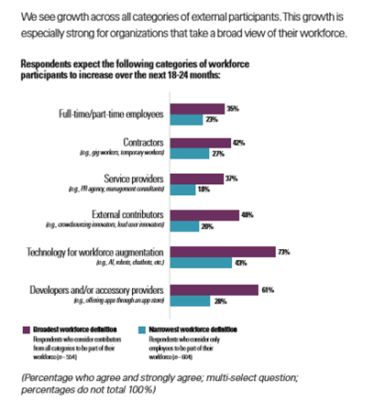
Fig 20: Workforce Participation Growth By Category
Workshop On Management Of Flexible Workforce

Slide 24
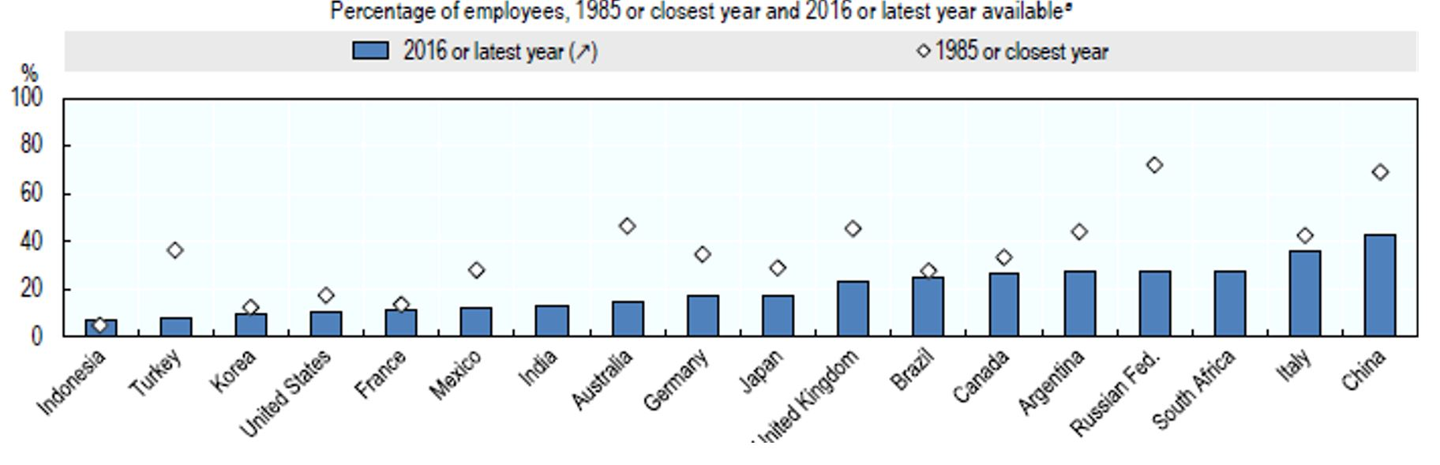
Fig 21: Trade Unions, and collective bargaining coverage in G20 Countries.
Workshop On Management Of Flexible Workforce

Slide 25
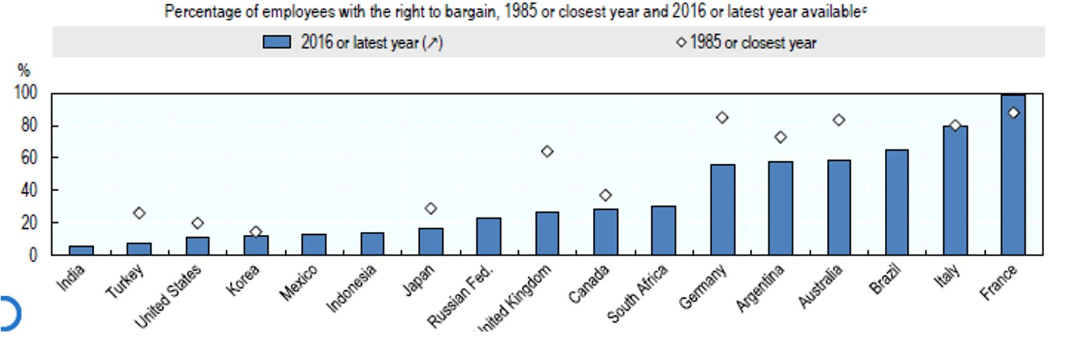
Fig 22: Collective Bargaining Average
Workshop On Management Of Flexible Workforce

Slide 26
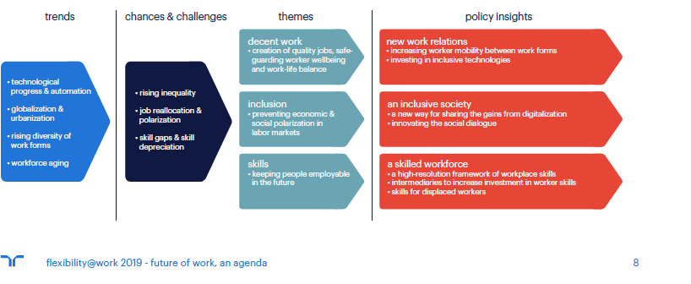
Fig 23: The Future of work, an agenda
Workshop On Management Of Flexible Workforce

Slide 27
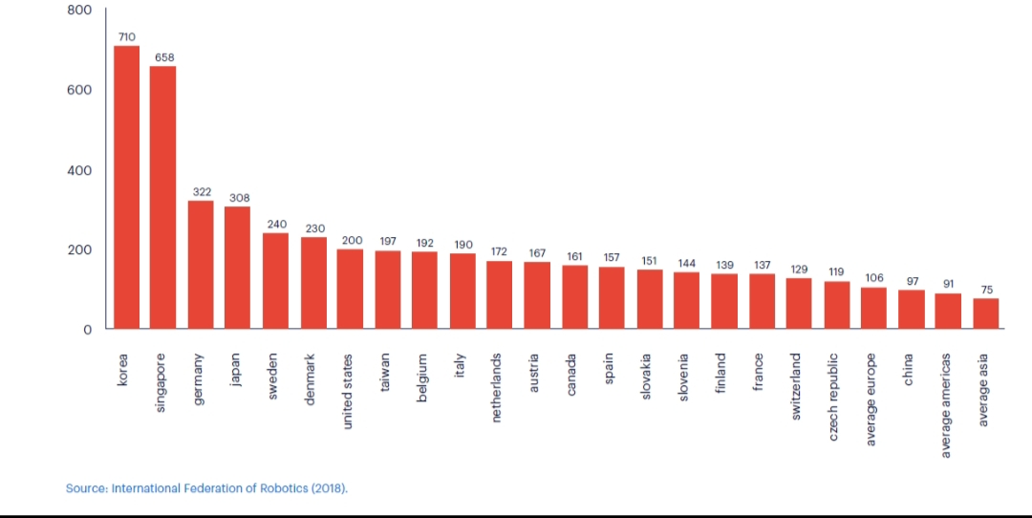
Fig 24: Industrial Robots per 10,000 manufacturing workers (data 2017)
Workshop On Management Of Flexible Workforce

Slide 28
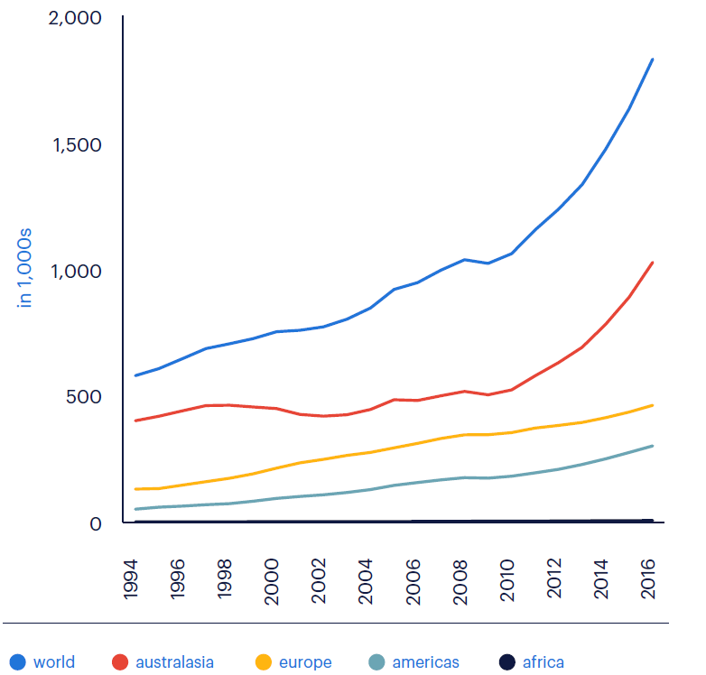
Fig 25: Stock of Industrial Robots Overtime
Workshop On Management Of Flexible Workforce

Slide 29
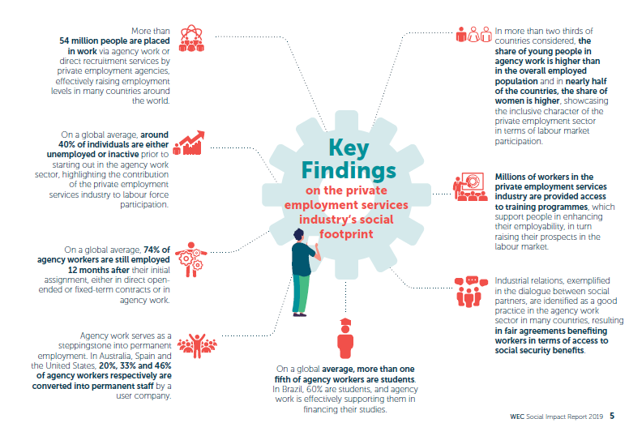
Fig 26: WEC Agency
Workshop On Management Of Flexible Workforce

Slide 30
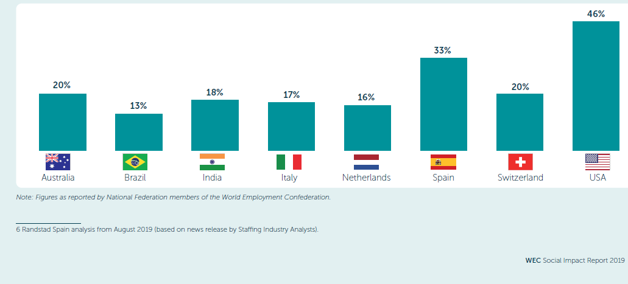
Fig 27: Conversion rates from temporary to permanent employment of agency workers, 2017
Workshop On Management Of Flexible Workforce

Slide 31
Fig 27: Conversion rates from temporary to permanent employment of agency workers, 2017
Workshop On Management Of Flexible Workforce

Slide 32
Summary and Conclusions
1)End of Permanent Jobs?
2)Never Ending emergency of newer business modes
3)Rise of precasious employment and deficit in decent work
4) Algorithms/AI guided Management Systems.
5)Labour regulations algorithm will future decline.
6)Worker representation and C B mechanisms will erode.
7)OS&H need of the hour
8)Robust policy framework to universalize social protection system.
9)Adequate and requisite set if skill required.
10)Business Ethics and corporate H R obligation.
Workshop On Management Of Flexible Workforce

Slide 33
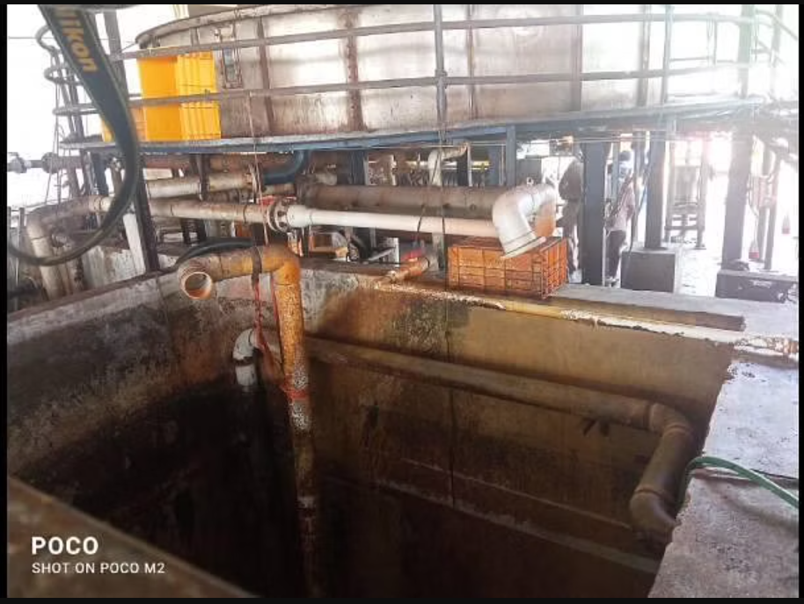
Workshop On Management Of Flexible Workforce

Slide 34
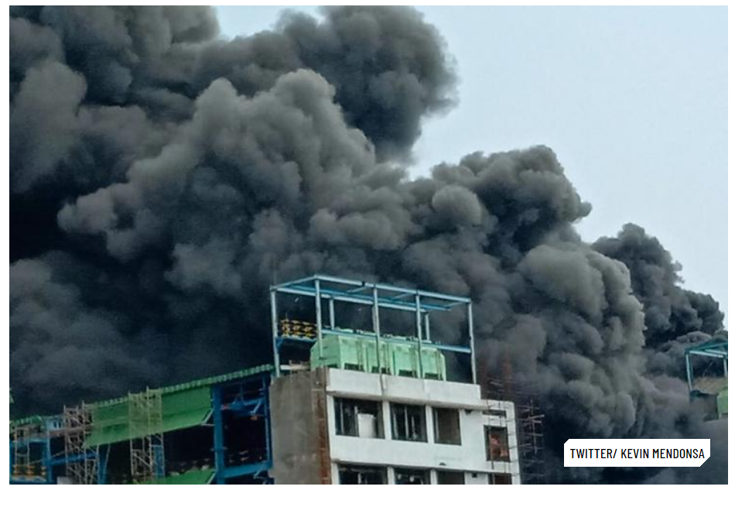
Workshop On Management Of Flexible Workforce

Slide 35
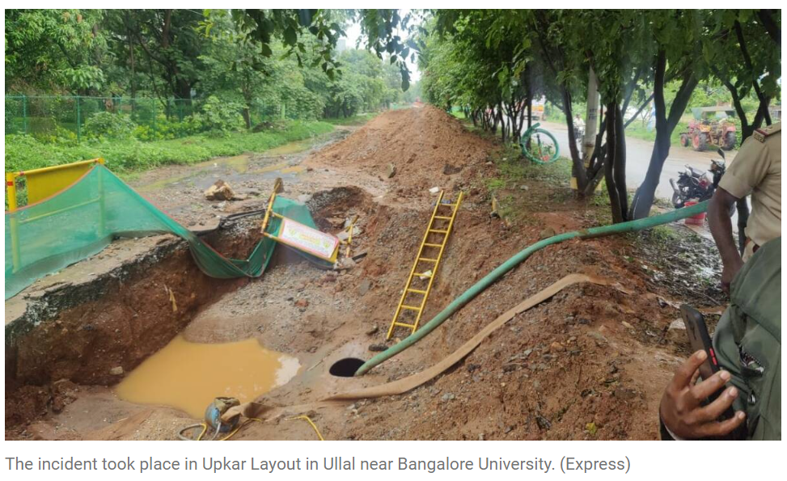
Workshop On Management Of Flexible Workforce

Slide 36

visit us : www.drmanjunathg.in
Workshop On Management Of Flexible Workforce

